Slide 1


AI Saturdays Kickoff
AI6 Week 1
Oxygen AI
Optimize Your Outcomes
AI6 Registration Form: https://docs.google.com/forms/d/e/1FAIpQLSd0wx35dx1NJI2C_ciyzoplneu1igltvEACI5KLN6FPWrhO8w/viewform
Notes:
AI6 Registration Form: https://docs.google.com/forms/d/e/1FAIpQLSd0wx35dx1NJI2C_ciyzoplneu1igltvEACI5KLN6FPWrhO8w/viewform

Slide 2
Agenda
845AM – Sign-in
910AM - Fast AI Discussion
10AM - Break
1030AM - CS224n Discussion
1130 - Break
12PM Close
Fast AI Lesson 1
CS224n Lecture 1
Other Items
Interest in MXNet
Study Kera-based FastAI

Slide 3

Fast AI – Week 1
Pre-Work
Video: http://course.fast.ai/lessons/lesson1.html
Lesson Wiki: http://forums.fast.ai/t/wiki-lesson-1/9398
Reading: Found in Lesson Wiki
Coding Goals:
Minimum: run through the Notebook and understand it
Ideal: Recreate the code from scratch without aid

Slide 4
Fast.AI Lesson 1:
Recognizing Cats and Dogs
Key Coding Concepts
Use of Jupyter Notebooks and Tricks
Use of ! for in-Notebook bash(shell) operations
Folder Structure for Image Classification
Python 3 conventions
format strings
Image File Format
The 3 Lines Used to Train the Model
Specify the Data
Specify the Model
Train the Model
Learning Rate; LR functions
lr_find() , plot_lr() , sched.plot()
Creating customized functions to view/check/visualize results and data

Slide 5
Fast.AI Lesson 1:
Recognizing Cats and Dogs
Key Theoretical Concepts
Training and Validation Sets
Logs and Natural Logs
”Infinitely Flexible” functions: Neural Networks
Convolutions
Convolutional Neural Networks
Gradient Descent
Learning Rate
Stochastic Gradient Descent
Notes:
AI6 Registration Form: https://docs.google.com/forms/d/e/1FAIpQLSd0wx35dx1NJI2C_ciyzoplneu1igltvEACI5KLN6FPWrhO8w/viewform

Slide 6
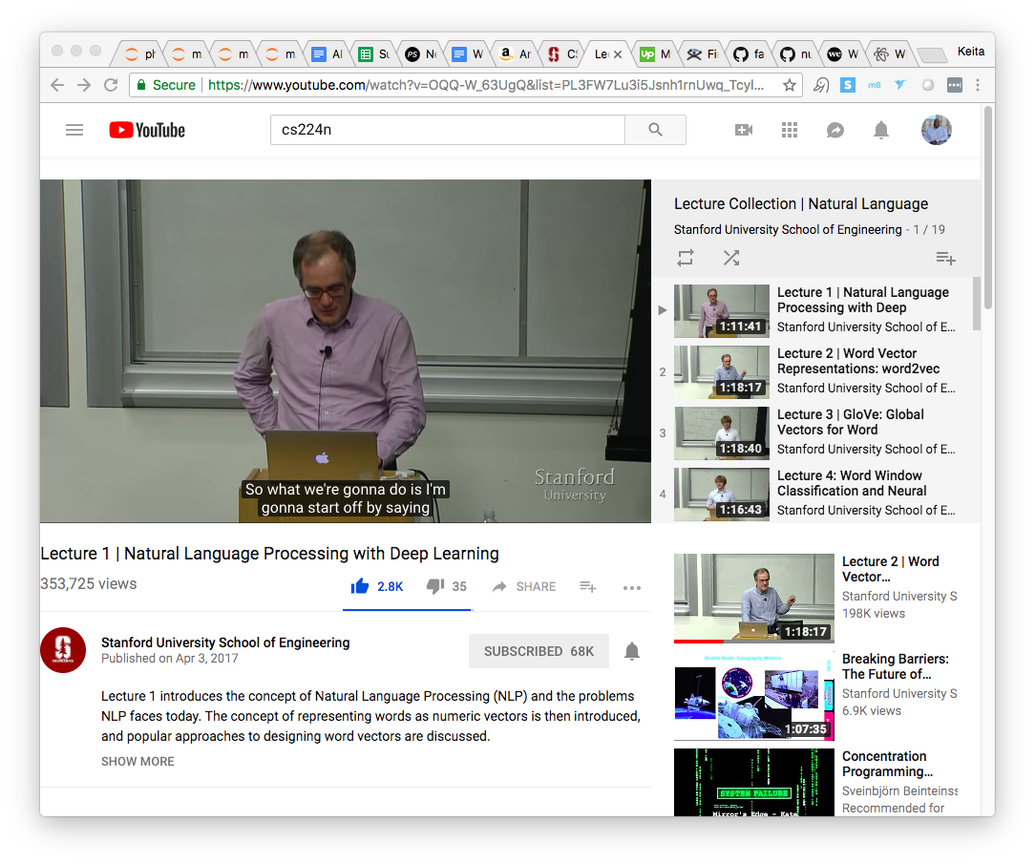
CS224n – Week 1
Intro to NLP & Deep Learning
Pre-Work
Video:
https://www.youtube.com/watch?v=OQQ-W_63UgQ&list=PL3FW7Lu3i5Jsnh1rnUwq_TcylNr7EkRe6
Slides: http://web.stanford.edu/class/cs224n/lectures/lecture1.pdf
Reading:
[Linear Algebra Review]
[Probability Review]
[Convex Optimization Review]
[More Optimization (SGD) Review]

Slide 7
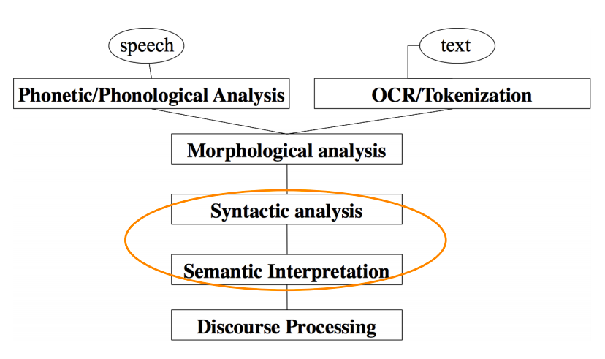
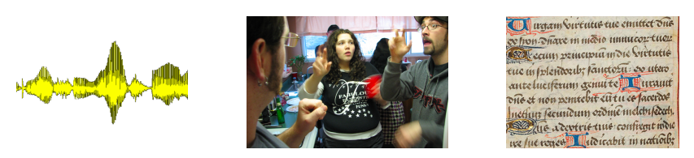
CS224n Lecture 1
Key Theoretical Concepts
NLP Levels
Inputs: Speech and Text and their Processing
Working out the parts of complex words
Working out the structure of sentences
Working out the meaning of sentences
Meaning of sentences given greater context
What’s special about human language
Human Language as data
Not an environmental signal; specifically used to communicate meaning
Language is a symbolic system encoded in a continuous substrate
Substrates: Sound (voice), images (writing; sign language)
Brains encode language using a continuous pattern of activation
Sparsity is a huge problem for machine learning of NLP
Introduction to Deep Learning
Human Generated Representations (features) vs Machine Learned Representations
The Deep in Deep Learning comes from the presence of multiple layers of representations
Why has DL started outperforming other methods?
Large amount of training data;
faster machines & high performing CPUs/GPUs
New models, algorithms and ideas
Notes:
AI6 Registration Form: https://docs.google.com/forms/d/e/1FAIpQLSd0wx35dx1NJI2C_ciyzoplneu1igltvEACI5KLN6FPWrhO8w/viewform

Slide 8
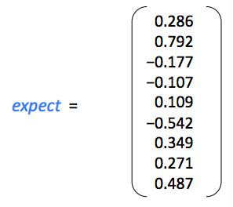
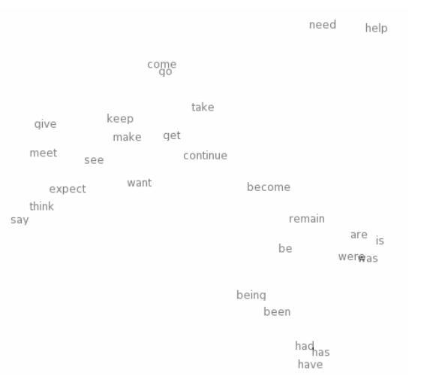
Key Theoretical Concepts, Cont.
Why NLP is Hard
Ambiguity vs non-ambiguity in programming languages
With language, humans leave a lot for others to infer
Deep NLP
Combining the ideas and goals of NLP with using representation learning and deep learning methods to solve them.
problem for machine learning of NLP
Word Representations
Representing word meaning as vectors in a high dimensional space
Words with similar meanings will cluster
Directions in these vector spaces will convey components of meaning
Morphology
Parts of words (morphemes) can be represented as vectors; Neural networks can combine compose the meaning of larger units out of these smaller pieces
Syntactic Parsers
Determine the structure of sentences
Semantics
DL: Since every word and logical expression is a vector, we can combine these elements to further convey meaning
”It’s all Vectors!”
Amazing thing is that we are using vectors to represent all types of language (sounds, words, parts of words, etc)
CS224n Lecture 1
Notes:
AI6 Registration Form: https://docs.google.com/forms/d/e/1FAIpQLSd0wx35dx1NJI2C_ciyzoplneu1igltvEACI5KLN6FPWrhO8w/viewform

Slide 9
Backup

Slide 10
Curriculum
Fast.ai - Practical Deep Learning For Coders - Part 1
Stanford CS224n: NLP with Deep Learning

Slide 11
Fast AI Detailed Overview
“Learn how to build state of the art models without needing graduate-level math—but also without dumbing anything down.”
Weekly Course Content
Recognizing Cats and Dogs
Improving Your Image Classifier
Understanding Convolutions
Structured, Time Series & Language Models
Collaborative Filtering. Inside the Training Loop
Interpreting Embeddings. RNN from Scratch
Resnets from Scratch

Slide 12
CS224n Detailed Overview
Weekly Course Content
Intro to NLP & Deep Learning
Word Vectors 1
Word Vectors 2
Neural Networks
Back Propagation
Intro to TensorFlow
Dependency Parsing
RNN and Language Models
Vanishing Gradients, Fancy RNNs
Machine Translation, Seq2Seq and Attention
Advanced Attention
Transformer Networks and CNNs
Co-reference Resolution
Tree RNNs and Constituency Parsing
Advanced Architectures and Memory Networks
Reinforcement Learning for NLP
Semi-Supervised Learning for NLP
Future of NLP Models, Multi-task Learning and QA Systems
“Students will learn to implement, train, debug, visualize and invent their own neural network models.”
Notes:
Syllabus: http://web.stanford.edu/class/cs224n/syllabus.html

